Slide 1
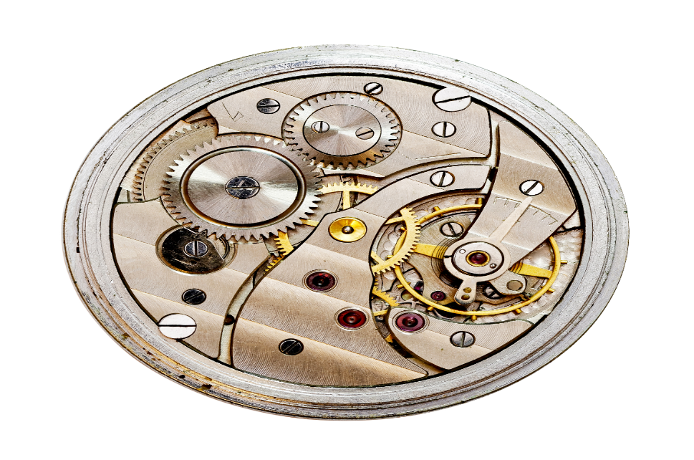
American Modern Insurance Group (AMIG)
ClaimCenter Fraud Analysis and Authorization Review
Deloitte Consulting Proposal
Oct 15, 2018

Slide 2

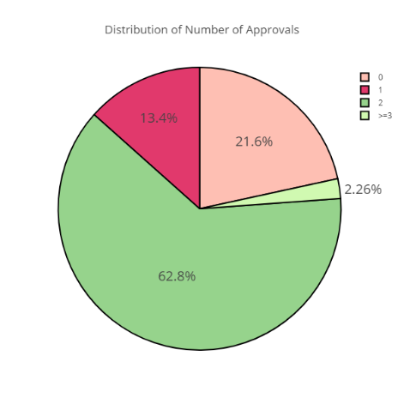
Fraud Scenarios
Number of approvals that a claim goes through
Scenario Detail
Summary of the # of approvals that a claim goes through along with the distribution of approvals in total and by claim handler
Method of Analysis
Find the # of approvals each claim has gone through and plot a pie chart of the same to see the distribution
Review average number of approvals by claim handler and compare to distribution to identify outliers
Analysis Results
Maximum (~63%) of the claims go through 2 approvals.
22% go through directly by the assigned user/ adjuster.
The % of claims that go through 3 or more users is 2%

Slide 3
Fraud Scenarios
Manual payments fraud
Scenario Detail
Manual checks are made without any management approval or with limited approval/sign-off.
Manual checks are deliberately made to the wrong parties or in excess of guidelines or approvals.
Method of Analysis
Transactions per claim handler – assuming a similar caseload, any noticeable changes in average transactions (i.e. checks cut) can raise a flag.
For every adjuster, compare the average per claim and volume of manual payments made against others for similar claim types / types of loss
Show distribution of number of manual payments in total and by adjuster
By adjuster, identify number of instances where named parties in checks and insured names do not match, and compare to total claim volume handled, manual checks, and total number of transactions
Analysis Results
Only one adjuster in the test data had made manual payments
This manual payment was in the range of 10-15% of the total payments made from that adjuster

Slide 4
Fraud Scenarios
Patterns of historical payments for each adjuster compared to the other adjusters (and this is done by experience level)
Scenario Detail
In a non-catastrophe scenario, if one adjuster has made 100 payments of $150 each for a certain type of claim, while the average payment of all other adjusters for such an event is only $50, a flag is to be raised and investigated further.
Method of Analysis
Compare the average payments made by loss type for each adjuster by analyzing their payments distribution with the distribute of all adjusters in that cohort.
Flag outliers by reviewing distribution of payments above the threshold mean
(Experience level unavailable in the data hence done it overall)
Analysis Results
Maximum payments by adjusters (above the threshold) have been made for cause of loss = ‘Explosion’ and ‘Burn or Scald’
Further deep dive should be done on these as next steps

Slide 5
Fraud Scenarios
Multiple payments to same party/vendor
Scenario Detail
Identify those adjuster and vendor combinations where there is a higher frequency/ severity of payments made (compared to others for the same adjuster for similar events/ causes)
Method of Analysis
We normalize the vendor names using Tax ID and fuzzy matching on names.
For each vendor we will see if there is any adjuster that captures a majority of all the payments that it receives. If so, that will be a probable pair of adjuster – vendor that we will want to deep dive in. Take Mean+SD as the threshold to flag those adjusters above the threshold as compared with the other adjusters.
To be performed by adjuster experience level cohort
Analysis Results
1. Fuzzy Match on PayTo Name
2. Combined PayTo with a threshold
3. For each loss cause and in each zip code, calculated payment done by each adjustor to Receiver
4. Calculated payment don to each receiver in that area for that particular cause
5. Calculated the percentage in dollar and frequency for each vendor- receiver pair with the total payment done to receiver (Step4)
6. Flag the receiver with skewed percentage for different adjustor

Slide 6
Fraud Scenarios
NEW SCENARIO
Multiple claims for the same type of loss
Scenario Detail
An insured files a claim with one type of loss. Months or 1-3 years later, the same insured files a claim with the same type of loss, handled by the same claim adjuster.
Method of Analysis
Identify instances of multiple claims filed from the same insured or same property address over time that are handled by the same claim adjuster. Occurrences should not be common, so any unusual activity should be investigated further with a comparison of claim amounts, accident date, and damage.
It’s possible that similar types of claims over time can be filed by the same insured, but a higher incidence of these types of occurrences within one adjuster, may raise a flag.
Analysis Results

Slide 7
Fraud Scenarios
Advisory allowance fraud
Scenario Detail
If the Insured is a general contractor who is working with 3-4 types of subcontractors, adjusters are allowed to bump the claim amount by a certain % as an advisory allowance. There is potential for abuse in these types of claims.
Method of Analysis
Identify if there a higher frequency of claims handled with advisory allowances present by adjuster. Review the percentage of claims handled by adjuster than include an advisory allowance, or if available, percentage of claims handled that involve sub-contractors that include an advisory allowance.
Also check for instances where there is a higher frequency of advisory allowances by adjuster for a specific insured, group of insureds or specific contractors
Analysis Results

Slide 8
Fraud Scenarios
Authority level fraud
Scenario Detail
Some adjuster privileges are changed immediately following catastrophes (hurricanes, tornadoes, floods, etc.) that occurred.
Adjuster is behaving differently in handling catastrophe claims which he/she normally wouldn’t do.
Method of Analysis
Compare payment distribution of each adjuster against the other adjusters in that region impacted by the catastrophe, and observe any deviation from their allowance limit
Compare payment distribution by adjuster before and after catastrophe, or prior catastrophes (within a 1-3 year window)
1. Filtered out the catastrophe claims
2. For each Loss cause and catastrophe, calculated mean payment
3. Marked payments done more than a threshold
Analysis Results

Slide 9
Fraud Scenarios
Adjuster overpaying the insured more than the approved amount (but staying within their authorization limit)
Scenario Detail
If an adjuster has a limit of $500 and an insured claims $300 in damages, there could be a situation where the adjuster approves a payment of $450 with fraudulent intent.
Method of Analysis
Identify frequency of occurrences where differences exist between the claimed and paid amounts for claims made below the authorization limit for each claim
Assume that the claimed amount is equal to the first case reserve set-up as the proxy to test this scenario
Co-brand Logo
1. Sorted the reserve created using CREATETIME and taken the first onceas proxy
2. Checked for the total payment done
3. Filtered out where overpayment is done
4. For each adjustor, calculated the amount and frequency of this over payment
Analysis Results

Slide 10
Fraud Scenarios
Adjusters with a history of irresponsible behavior (Number of claims guidelines / rules broken)
Scenario Detail
If there are a lot of complaints from claimants about adjusters (bad faith allegation, non-timely payments, etc.), and/or adjusters are historically found to be non-compliant with guidelines – flag to be raised.
Method of Analysis
Review the historical performance and conduct of each adjuster to identify number of occurrences of non-compliance / misconduct cases for each adjuster. Adjusters with a higher # of historical non-compliance / misconduct cases are the ones to be flagged and reviewed further.
1. Brought special ivestigation index into each claim
2. If nan, marked it as 0
3. Calculated the frequency for each adjustor more involved in those cases
Analysis Results

Slide 11
Fraud Scenarios
Claim adjuster demographics: Years experience, years at company, and/or credit score of adjuster among other external variables to be analyzed
Scenario Detail
If available, reference external databases (NICB, EASI, ISO/Verisk, LexisNexis, credit bureaus, etc.) and use the third party information about the adjusters to identify greater propensity of fraudulent claim handling practices. Prior fraudulent history, and/or financial responsibility (as indicated by credit scores) can be predictive of current instances of fraud.
Method of Analysis
Leverage external information to identify a higher propensity of fraud among claim adjusters or even insureds
Use NICB database to identify insureds with insurance fraud history, and use that information to identify suspicious activity with respect to insured-adjuster combinations
Analysis Results

Slide 12
Fraud Scenarios
Users (claim managers and/or adjusters) changing authority limits frequently
Scenario Detail
A user (claim manager or adjuster) changes his/her authority limits frequently and uses that to make higher than expected claim payments
Method of Analysis
Identify users with role as Manager to change authority limits (i.e., Who has role 'User Admin' Assigned to them)
Observe those managers or claim adjusters with a higher frequency of changes in authority limits
Determine average payments made before and after authority limits were granted within a set time period (two weeks, a month, etc.) by adjuster. Compare change in average payments by adjuster before and after authority limits changed
Analysis Results

Slide 13
About Deloitte Deloitte refers to one or more of Deloitte Touche Tohmatsu Limited, a UK private company limited by guarantee, and its network of member firms, each of which is a legally separate and independent entity. Please see www.deloitte.com/about for a detailed description of the legal structure of Deloitte Touche Tohmatsu Limited and its member firms. Please see www.deloitte.com/us/about for a detailed description of the legal structure of Deloitte LLP and its subsidiaries. Certain services may not be available to attest clients under the rules and regulations of public accounting.

